Slide 1
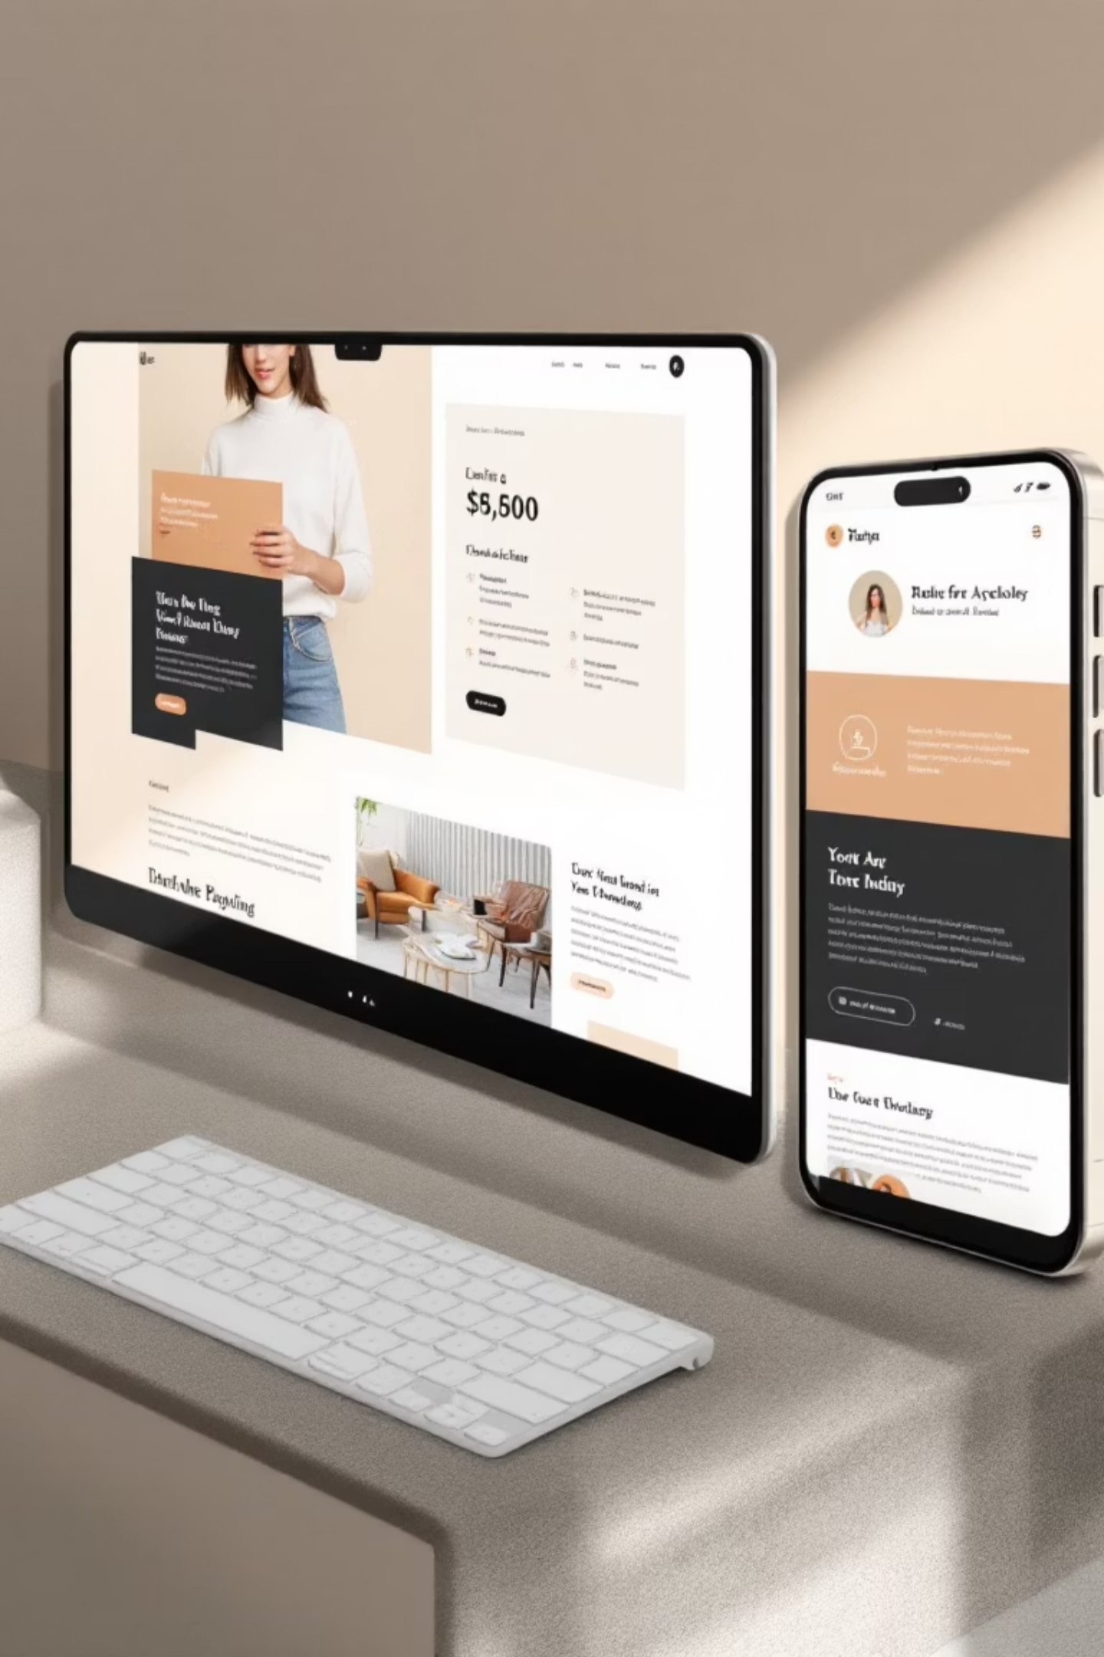
Hessa6 Website Redesign
HCI Project - Website Redesign
Project Overview
This project involved a complete redesign of the Hessa6 website, focusing on enhancing user experience and modernizing its appearance. Our goal was to deliver a sleek, professional platform that is both visually appealing and fully functional.
Explore the new website here: https://hessa6.org/
The redesign brings significant improvements in aesthetics, navigation, and overall site performance, ensuring a seamless experience for all users.

Slide 2
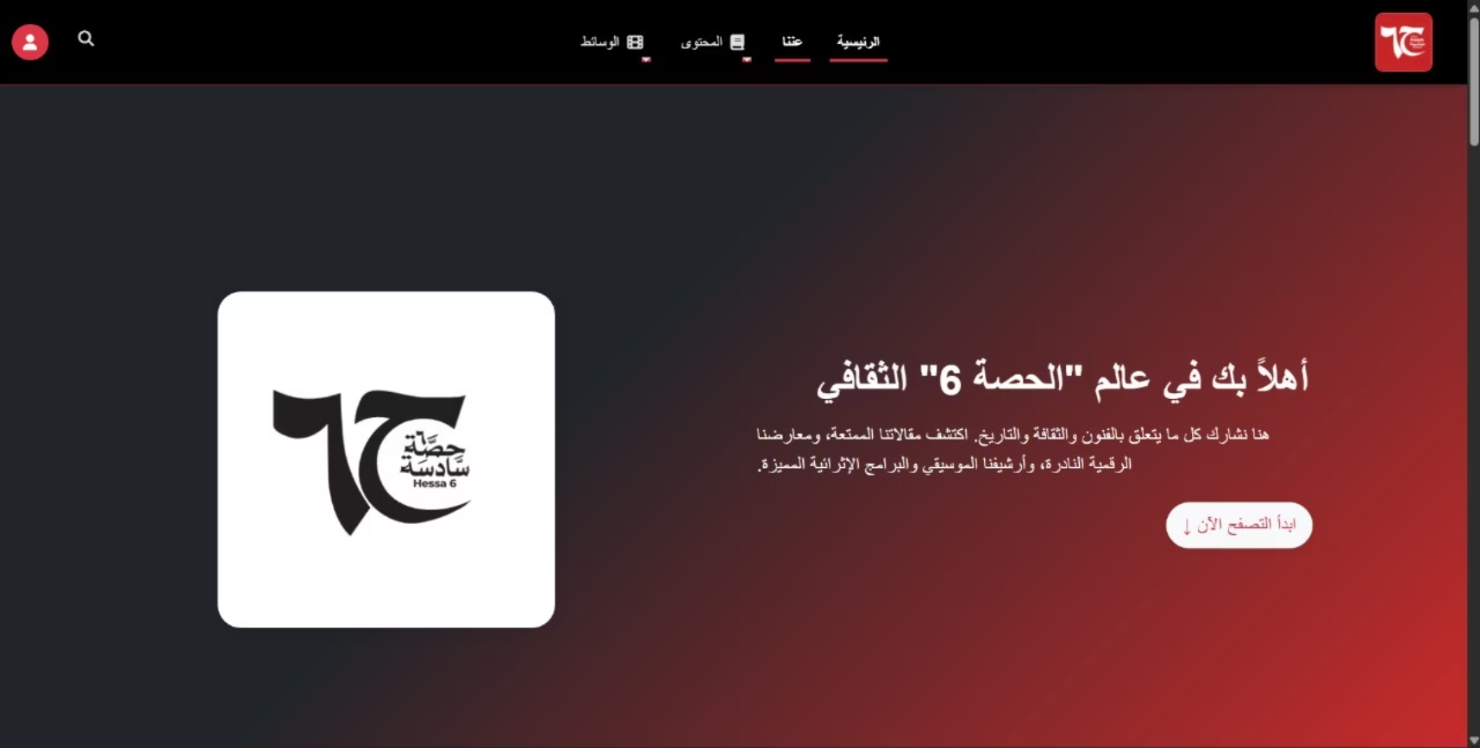
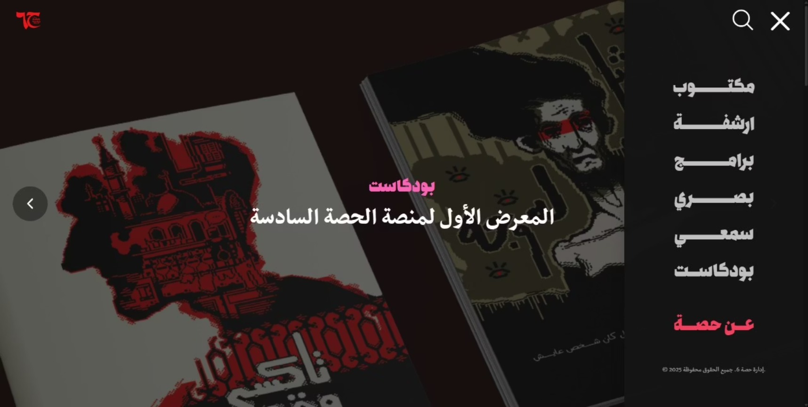
Hero Section Redesign
Old Design
New Design
Key Improvements
Cleaner, minimalist layout
Better visual hierarchy with logo and text positioning
Improved spacing and typography
More professional and contemporary aesthetic
Sidebar navigation with improved styling and fonts
Better user experience with responsive design
Enhanced navigation accessibility compared to old unresponsive design

Slide 3
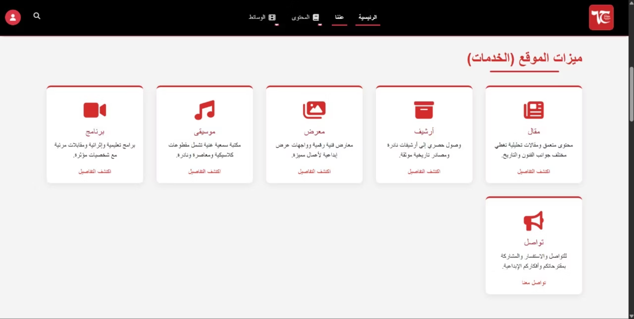
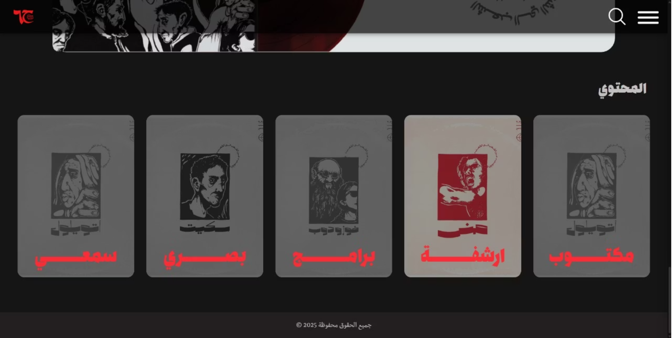
Content Section Redesign
Old Design
New Design
Key Improvements
Dark theme with modern aesthetic
Enhanced card design with visual depth
Improved hover effects and interactive states
Integration of images/artwork in cards
Better visual hierarchy with red accent highlights
Responsive design optimized for mobile devices
Clearer focus and user engagement
Better spacing and typography

Slide 4
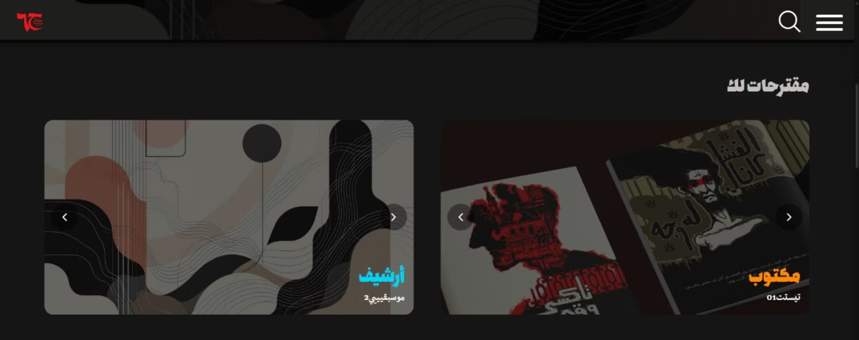
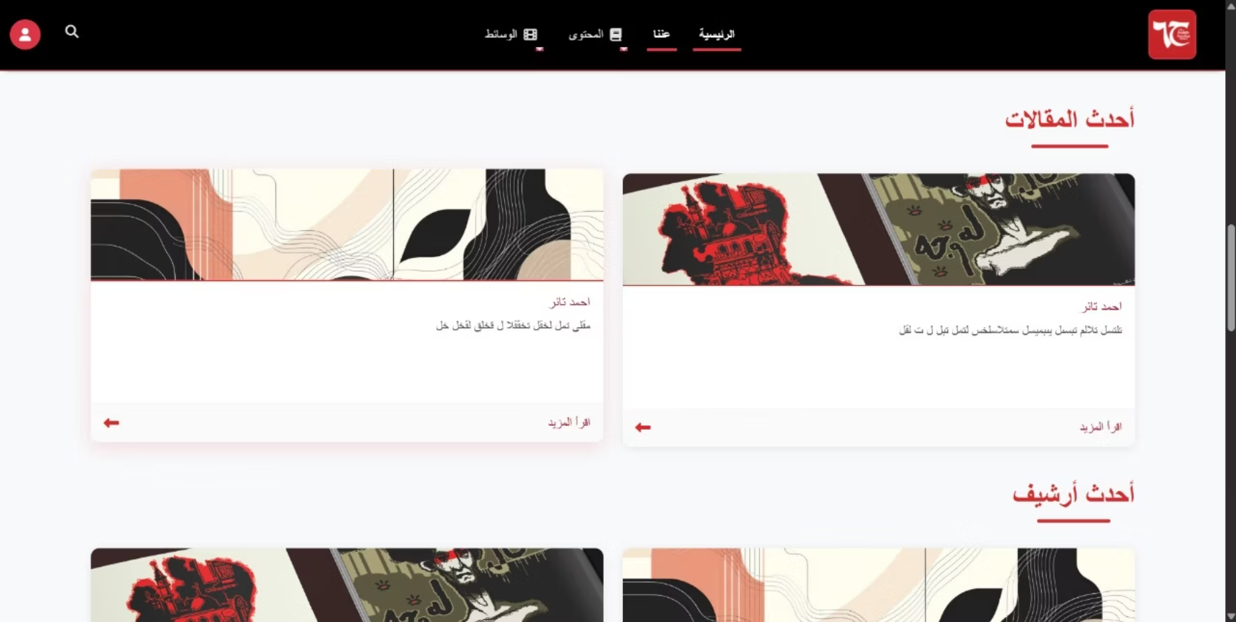
Posts Section Redesign
New Design
Old Design
Key Improvements
Consolidated posts into organized sliders (2 posts per slider)
Better content organization and grouping
Consistent card styling across all sections
Integrated slider navigation controls
Fully responsive design optimized for mobile devices
Improved space efficiency
Enhanced content discovery and navigation
Maintains dark theme consistency throughout

Slide 5
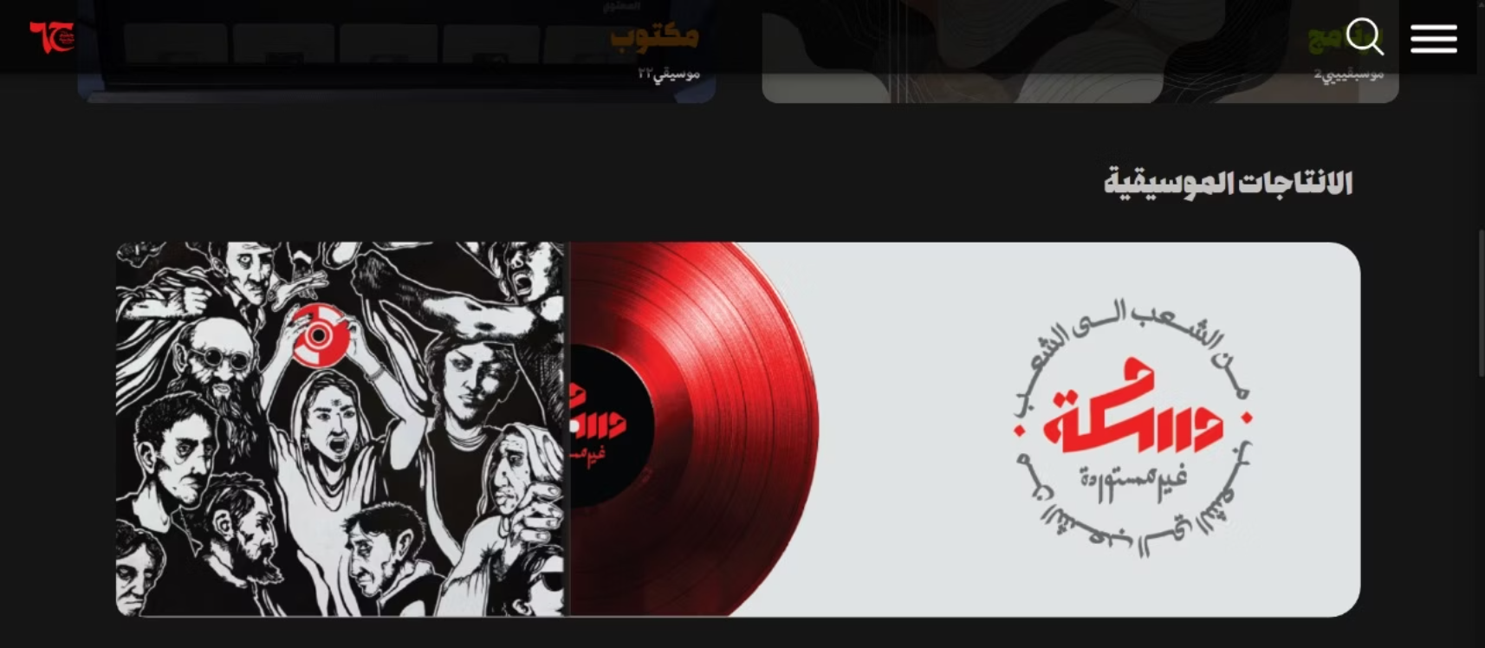
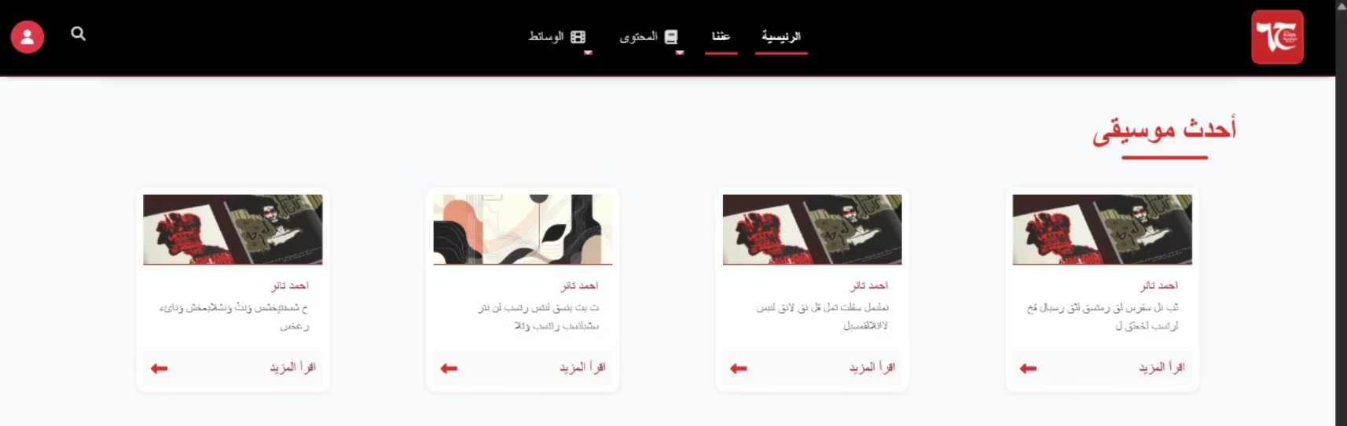
Music Section Redesign
New Design
Old Design
Key Improvements
Modern layout with prominent album artwork
Enhanced card design with better visual depth
Larger, higher-quality album cover displays
Improved spacing and padding between elements
Consistent dark theme with better contrast
Fully responsive design optimized for mobile devices
Better visual hierarchy and user engagement
Improved typography and text styling

Slide 6
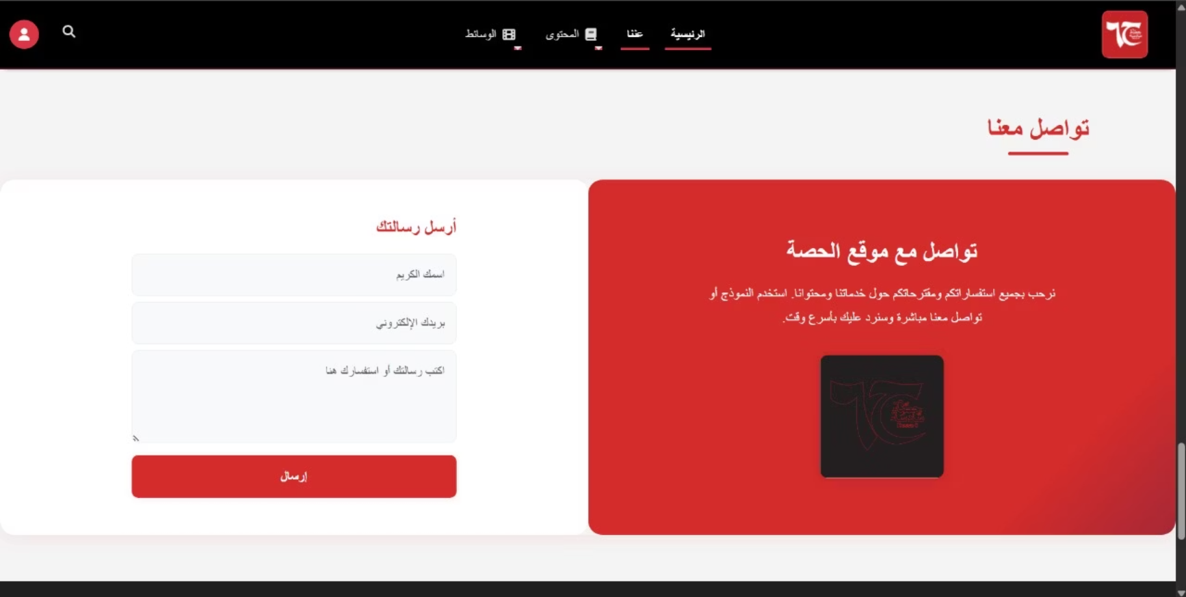
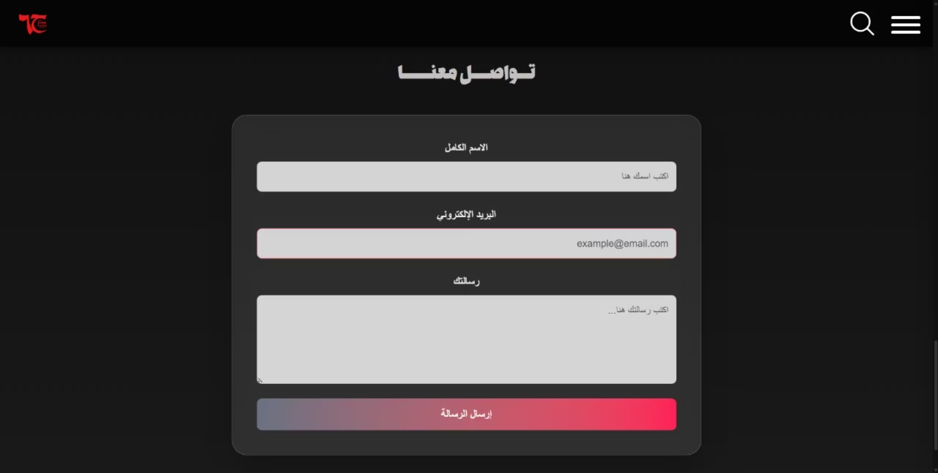
Contact Section Redesign
Old Design
New Design
Key Improvements
Centered modal/card layout for better focus
Modern styled input fields with improved contrast
Better visual hierarchy and form organization
Prominent gradient call-to-action button (red to pink)
Cohesive form card design
Dark theme integration throughout
Improved user experience and interaction flow
Better responsive design for different screen sizes
Cleaner, more professional appearance

Slide 7
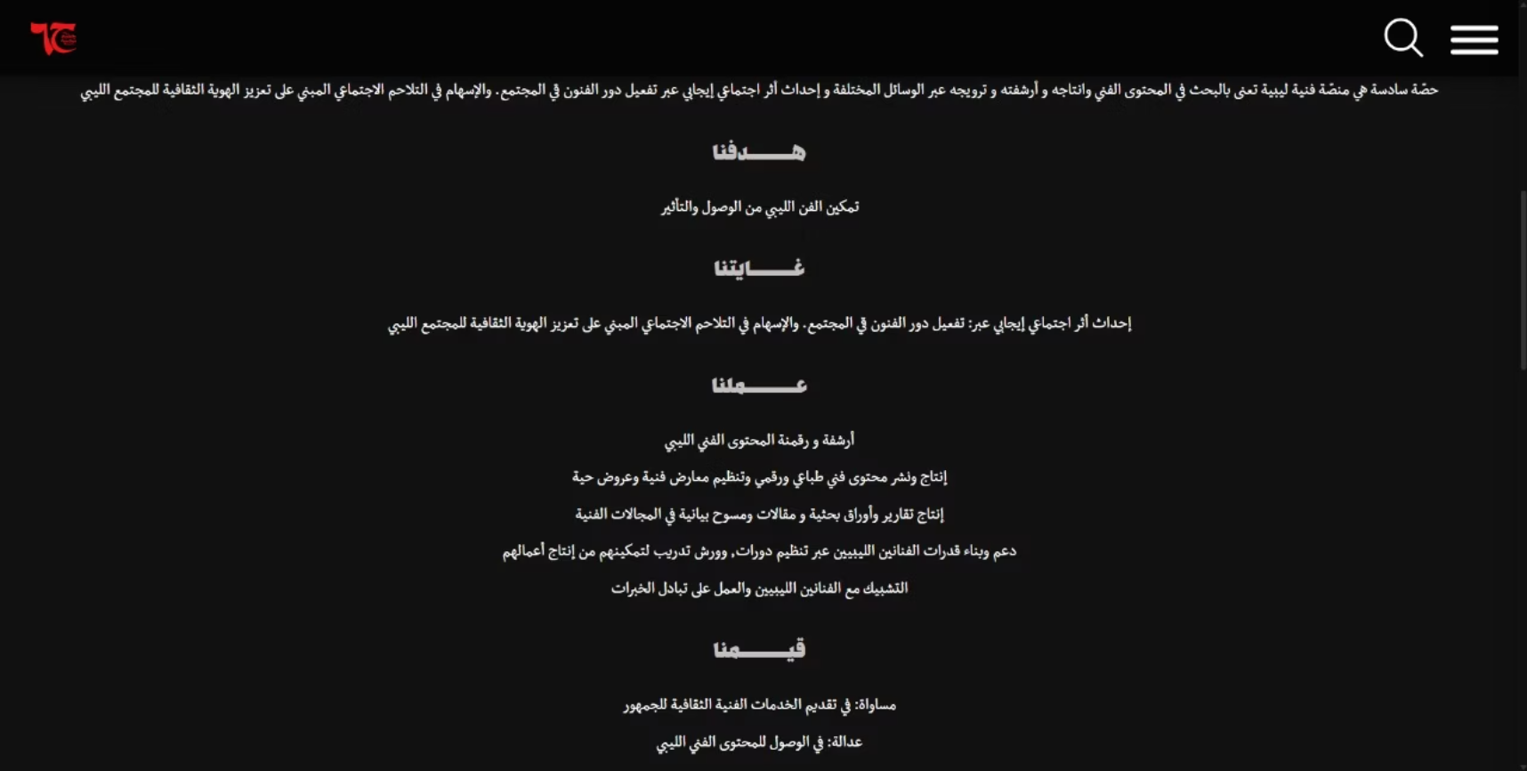
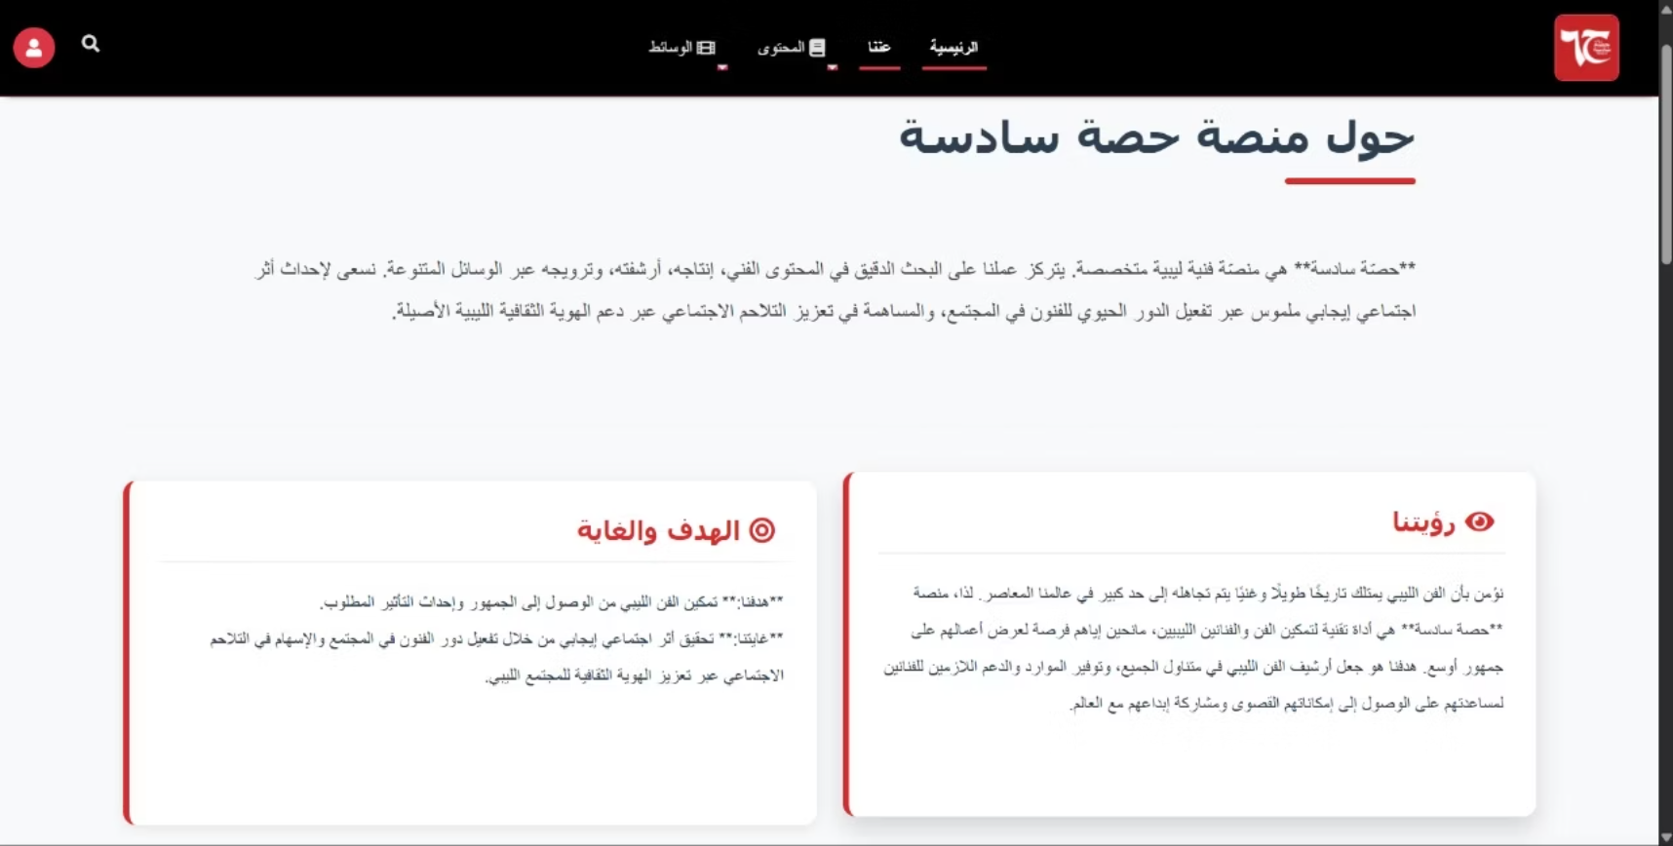
About Us Content Redesign
New Design
Old Design
Key Improvements
Structured layout with organized sections
Better typography and font hierarchy
Better spacing and padding between sections
Enhanced readability and content scanning
Decorative visual elements for engagement
More professional and polished appearance
Improved user experience and content digestibility

Slide 8
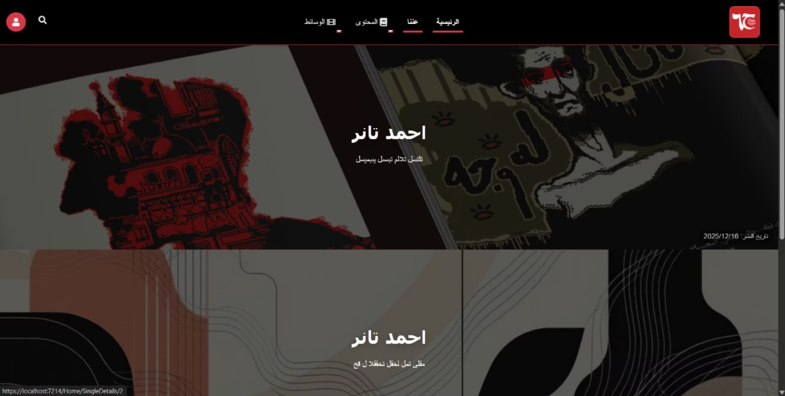
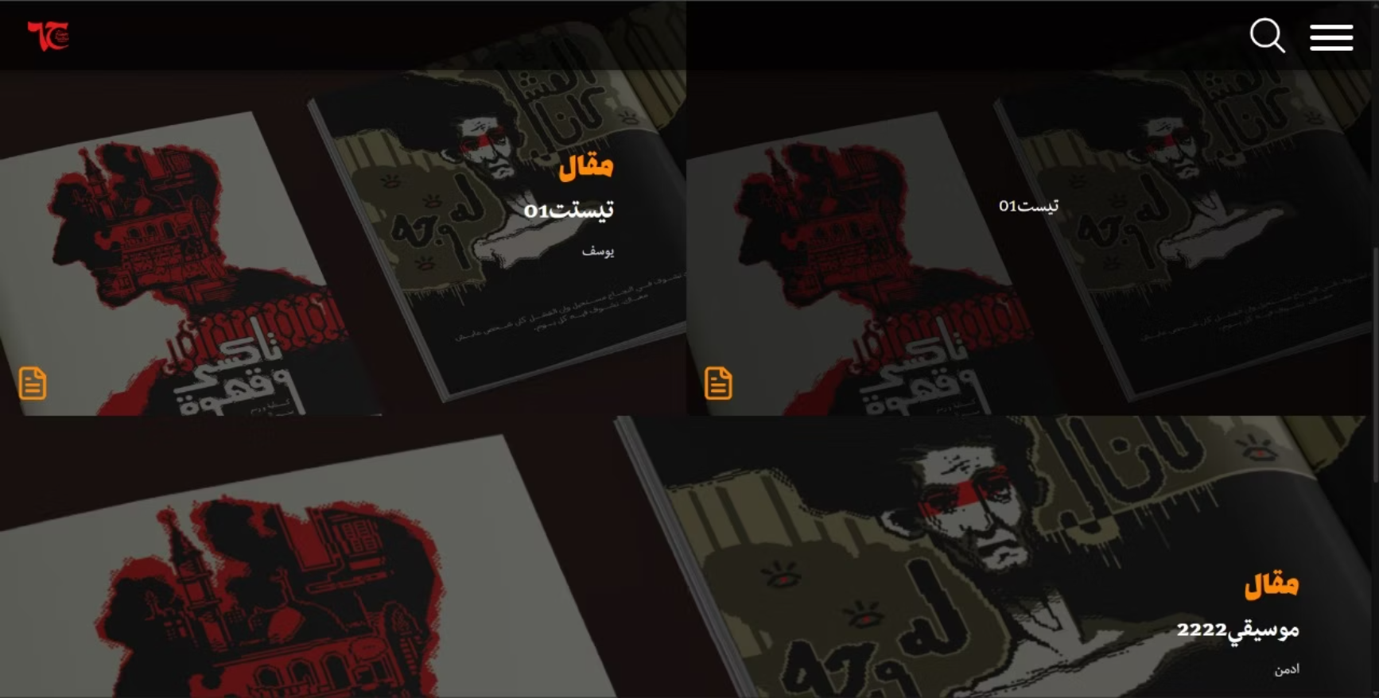
Subcategory Pages Redesign
Old Design
New Design
Key Improvements
Elegant multi-column grid layout with better spacing
Enhanced card design with improved visual depth
Interactive hover effects revealing descriptions
Better image display with consistent aspect ratios
Improved typography and text positioning
Dark theme with better color contrast
Interactive hover states
Better responsive design for different screen sizes
Enhanced content discoverability and user engagement

Slide 9

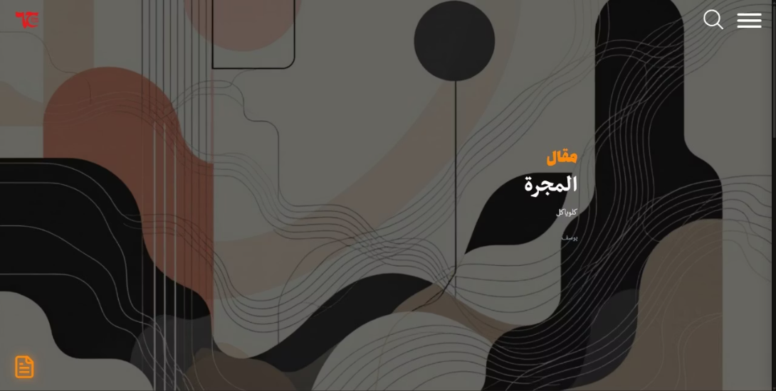
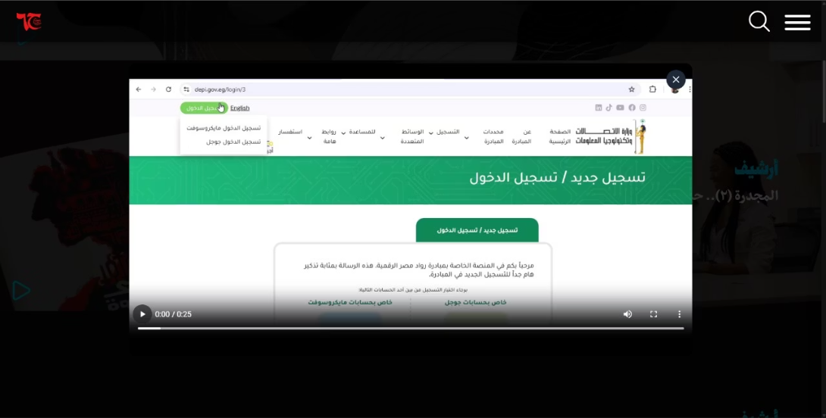
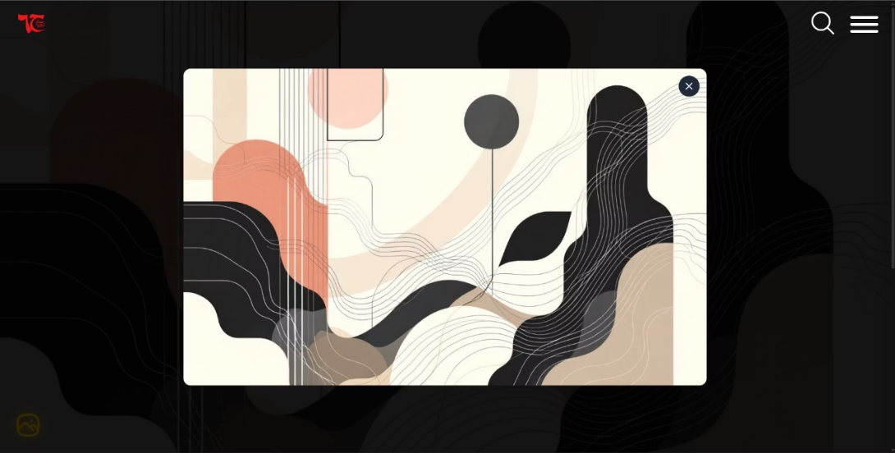
Category Pages - Interactive Features
Enhanced Hero Section - Full Desktop Height
Video Preview Modal - Archive Category
Image Preview Modal - Other Categories
Key Features
Enlarged hero section utilizing full desktop height for better UX
Interactive modal windows for quick content preview
Video preview modal for archive category (play button triggers video display)
Image preview modal for other categories (shows main image without entering details page)
Quick preview functionality without navigating to full post details
Modern modal design with clean presentation
Consistent interactive features across all category pages
Improved user engagement and content discovery

Slide 10
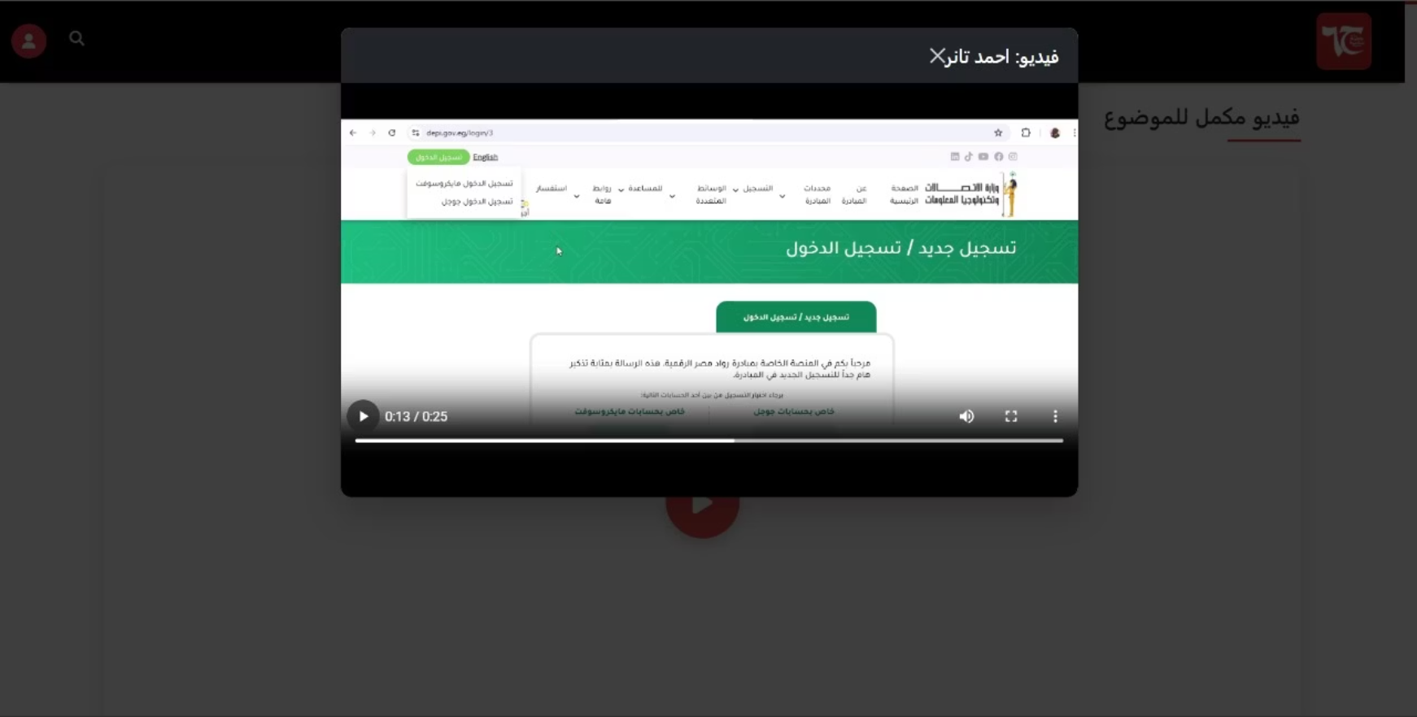
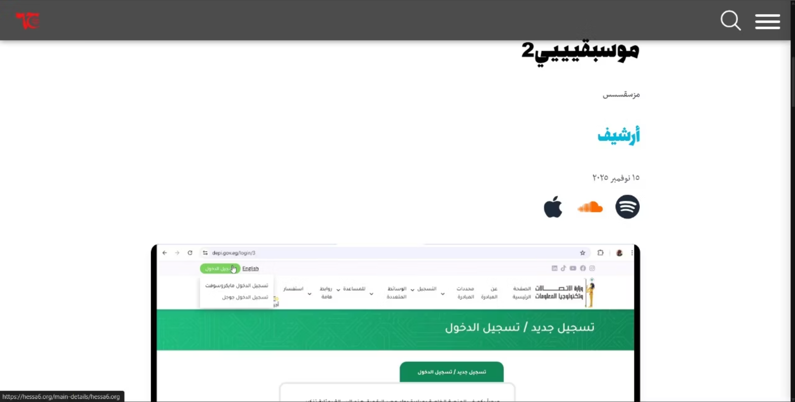
Post Details Page Redesign
Old Design
New Design
Key Improvements
Clean, dedicated page layout with light background
Spacious, organized content presentation
Clear visual hierarchy with title and breadcrumbs
Better typography and text spacing
Improved navigation elements and structure
Light background for enhanced readability
Professional and modern appearance
Better content focus without distracting overlays
Optimized responsive design for all screen sizes
Enhanced user experience for content consumption

Slide 11
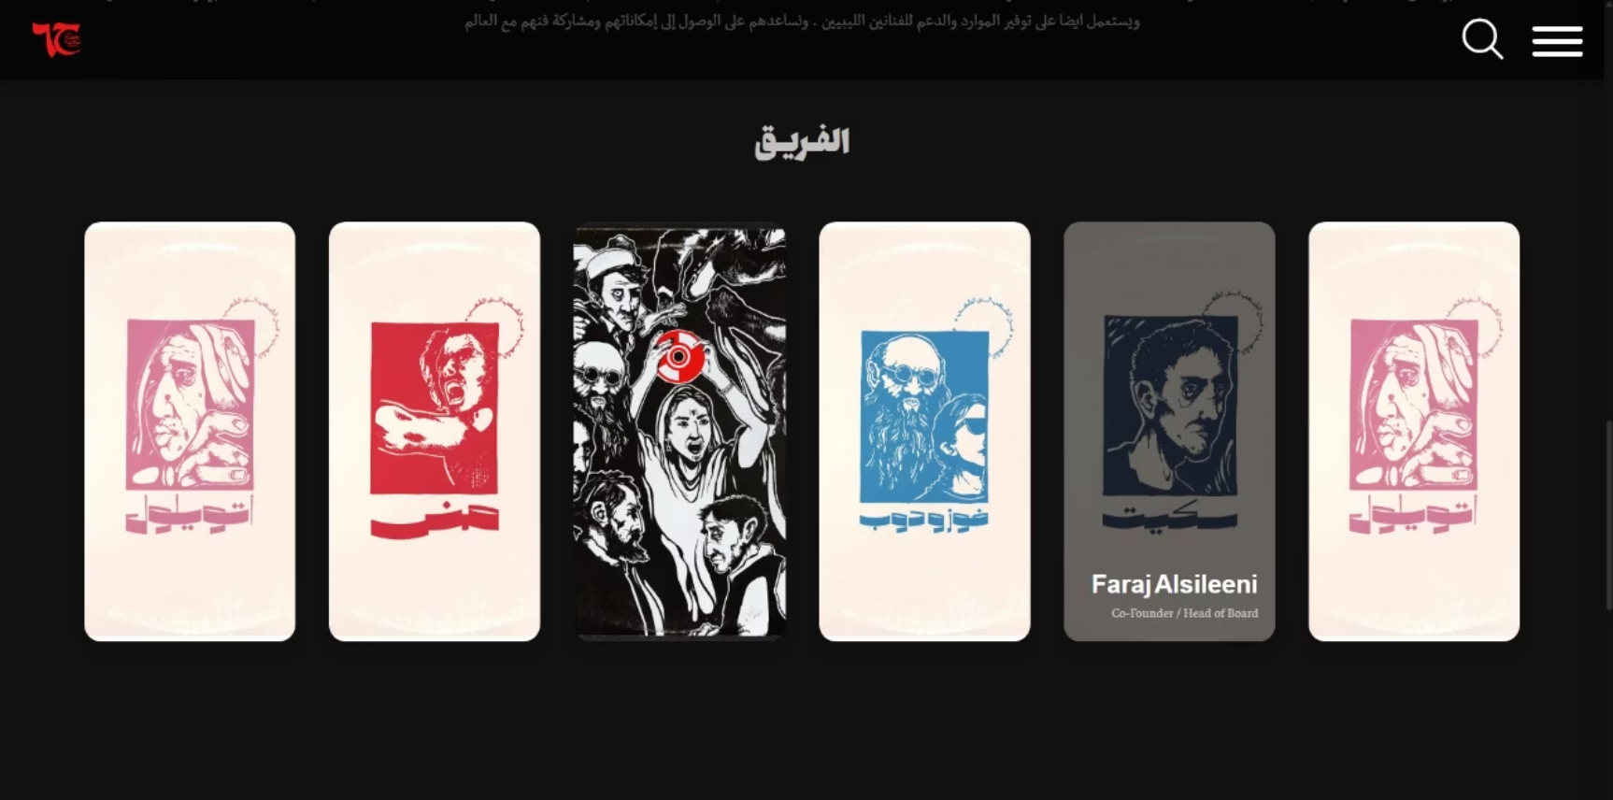
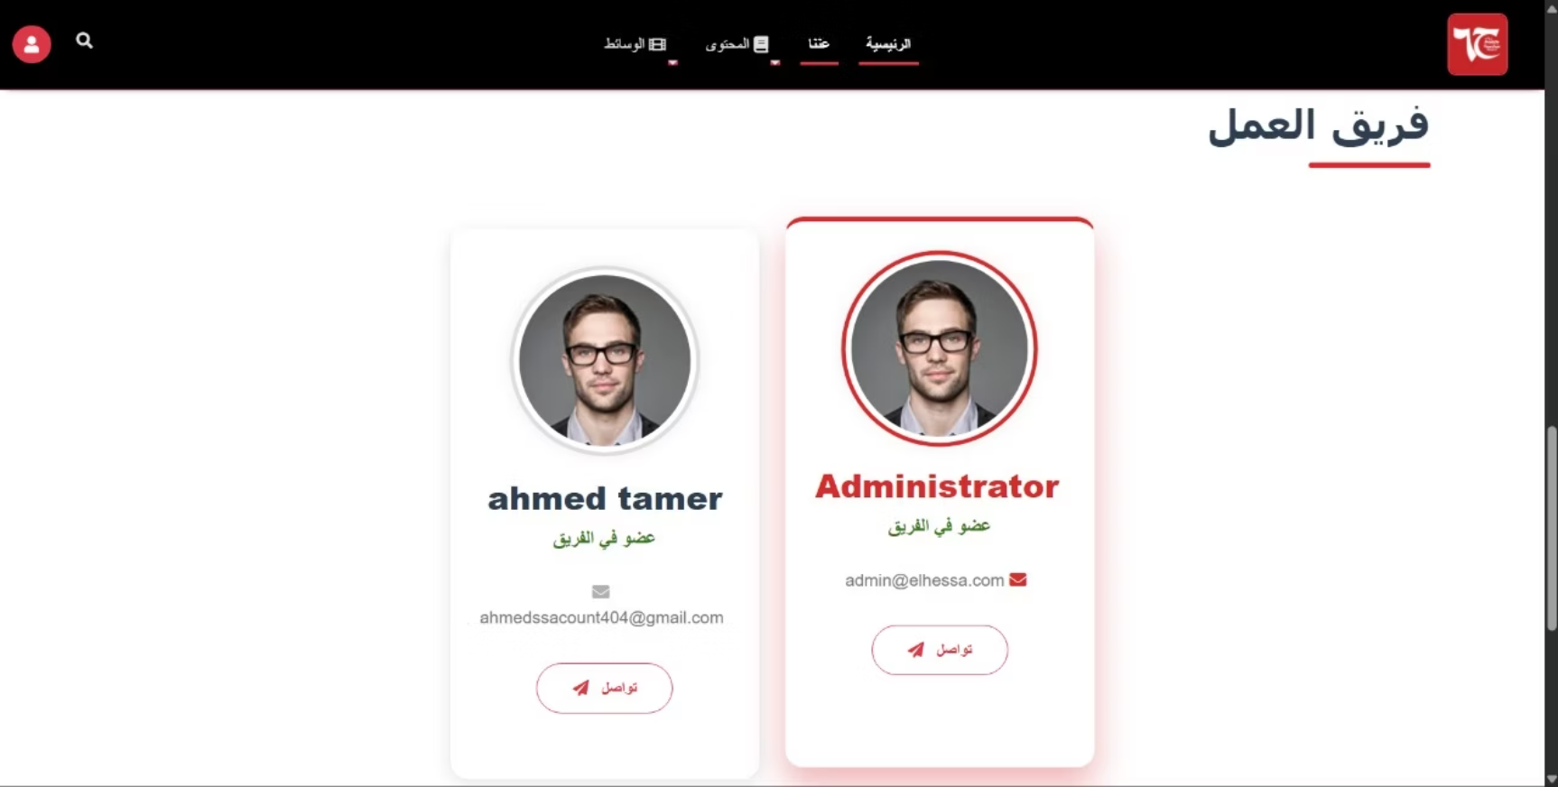
Team Members Section Redesign
New Design
Old Design
Key Improvements
Modern card-based design with visual depth
Enhanced hover effects and interactive states
Prominent role badges and member information
Dark theme integration throughout
Improved typography and text styling
Better responsive design for different screen sizes
Cleaner, more professional appearance
Increased user engagement with interactive elements

Slide 12
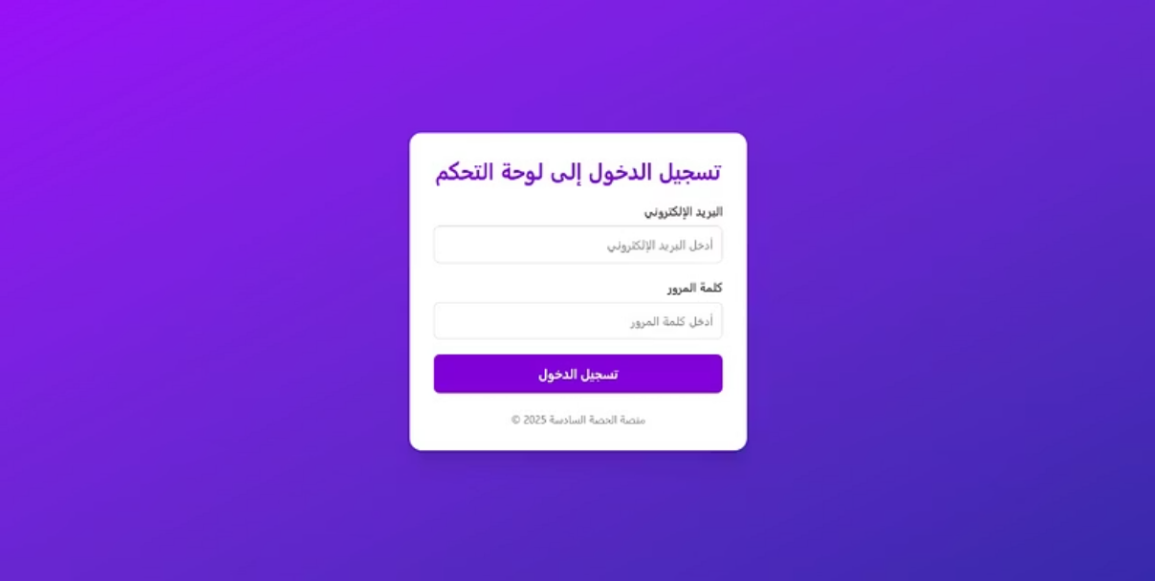
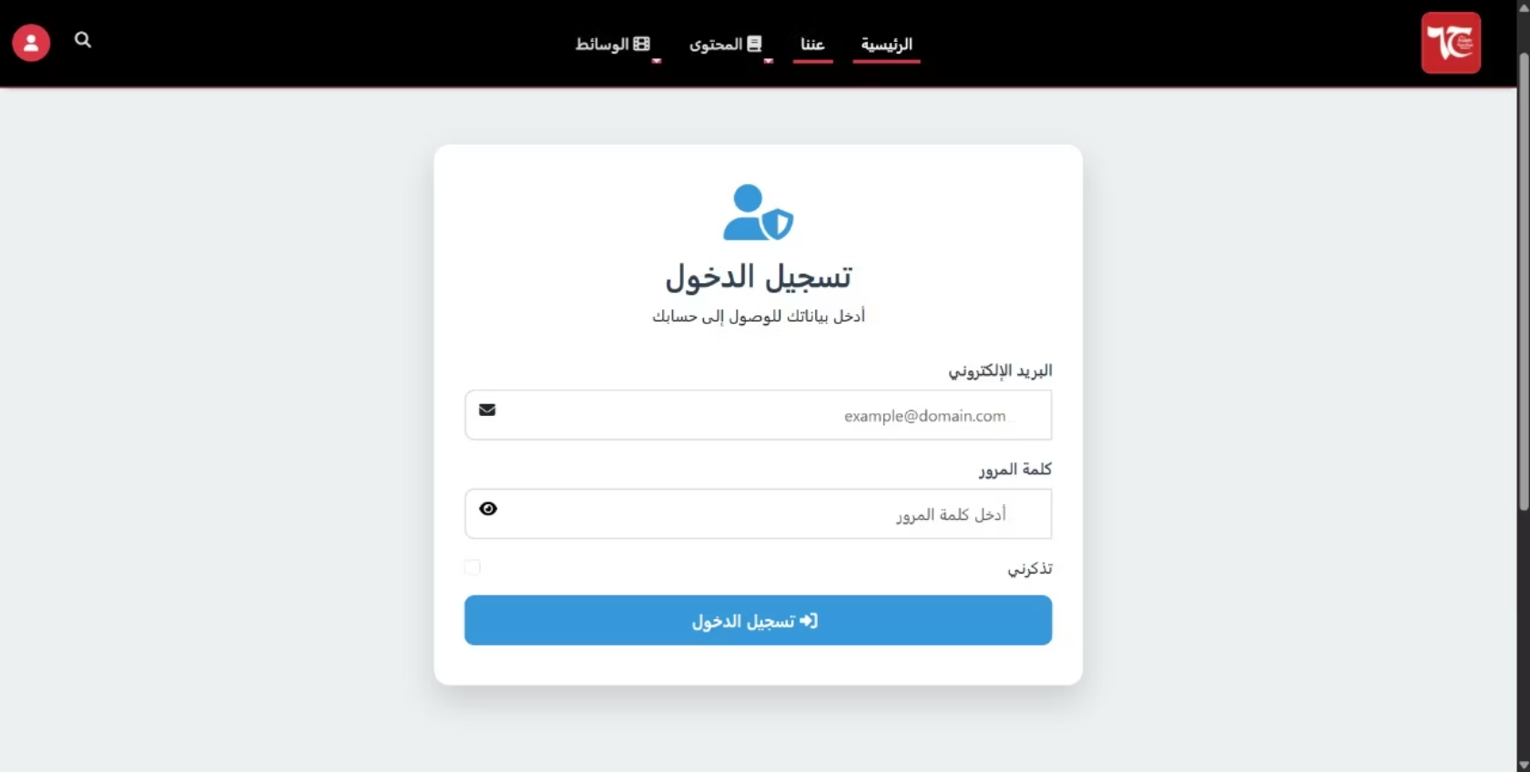
Category Pages Redesign
New Design
Old Design
Key Improvements
Clear visual hierarchy to easily identify key information.
Ample white space for improved readability and reduced cognitive load.
Logical grouping and intuitive cues for easier navigation and content discovery.
Enhanced user experience with a clear and coherent visual flow.

Slide 13
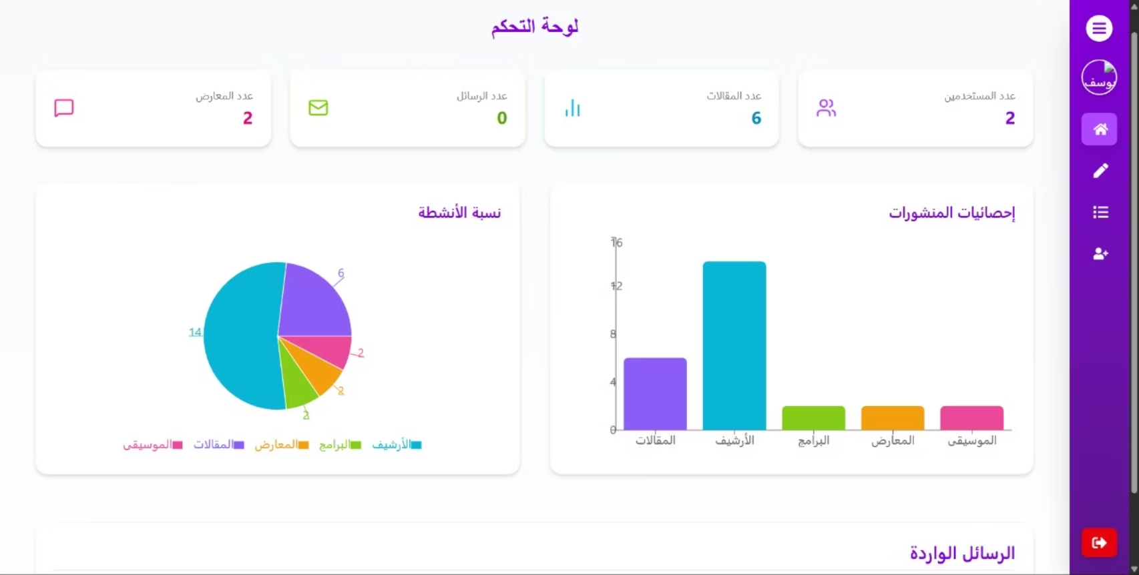
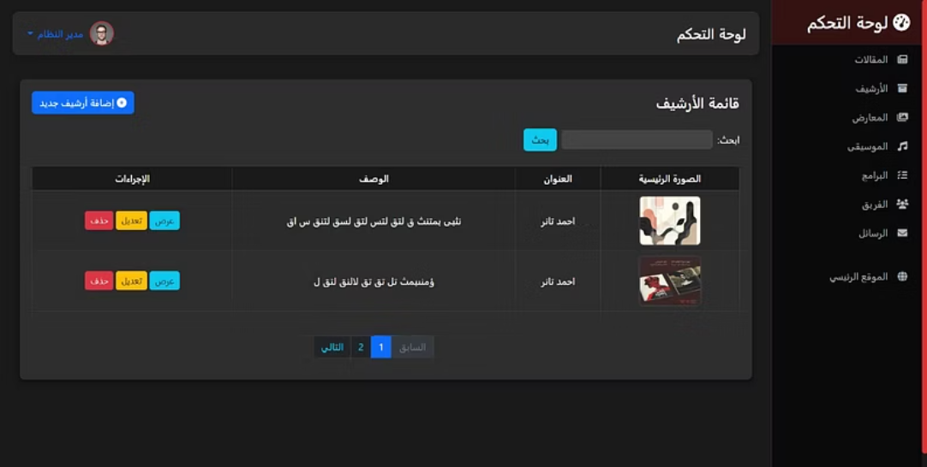
Category Pages Redesign
New Design
Old Design
Key Improvements
The new layout provides a clearer, more organized visual structure.
Content is now grouped more logically, making information easier to digest.
Enhanced readability improves how quickly users can process information.
Navigation has been streamlined, allowing for more intuitive browsing of categories.
Better responsive design for different screen sizes.
These changes collectively contribute to a more efficient and positive user experience.

Slide 14



Our Team
Ahmed Tamer Sameer AbdelGawad
Yousef Hussien Ibrahiem Omara
Ahmed Mostafa Ibrahiem AbdelWahed
We extend our sincere thanks to each team member for their invaluable collaboration and hard work on this Human-Computer Interaction (HCI) project.

Slide 15

Thank You
We extend our sincere gratitude for your attention today. This presentation detailed the comprehensive redesign of the Hessa6 website.
Experience the new and improved platform yourself:
https://hessa6.org/
Our focus on modern aesthetics, enhanced functionality, and intuitive user experience has culminated in a website that truly elevates the digital presence of Hessa6. We are confident these significant improvements will provide an exceptional experience for all users.

